Slide 1


NS
LECTURE
Firewall Deployment & Configuration
Network Security
Diploma in CSF
Year 3 (2020/21), Semester 5
3
Notes:
Source: Jones and Bartlett Learning © 2014 , LLC, an Ascend Learning Company www.jblearning.com
Textbook: J Michael Stewart, Network Security, Firewalls, and VPNs, Jones & Bartlett Learning (2014)
- Mostly from Chapter 2 Firewall Fundamentals

Slide 2
Objectives
At the end of this, you will get to know more about firewalls:
TCP/IP Protocols
Interface Management Profile
DHCP
Virtual Routers
NAT

Slide 3
Recall: TCP/IP Protocols
DNS
DHCP
HTTP
HTTPS

Slide 4
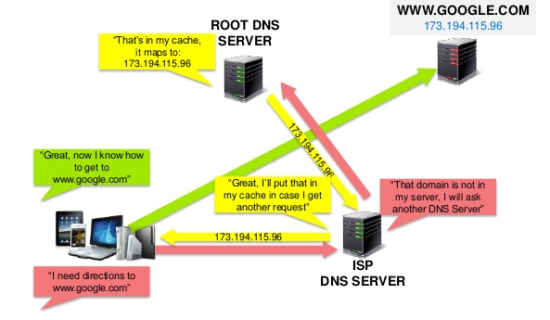
DNS (Domain Name System)
TCP and UDP port 53
Users do not keep track of IP address of servers
To access the servers (e.g. file servers, social networking sites), users rely upon the DNS to resolve the fully qualified domain names (FQDNs) into the associated IP address

Slide 5
DHCP (Dynamic Host Configuration Protocol)
Dynamic Host Configuration Protocol (DHCP) is a client/server protocol that automatically provides an Internet Protocol (IP) host with its IP address and other related configuration information such as the subnet mask and default gateway.
The DHCP employs a connectionless service model, using the User Datagram Protocol (UDP). UDP port number 67 is the destination port of a server, and UDP port number 68 is used by the client.
Quick Question: Which networking device can be configured as a DHCP server?
Notes:
A router, a residential gateway, a firewall.

Slide 6
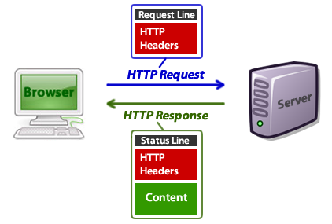
HTTP (HyperText Transfer Protocol)
TCP Port 80

Slide 7
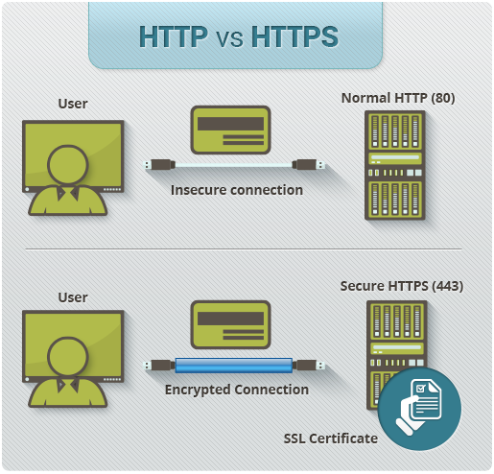
HTTPS (HyperText Transfer Protocol Secure)
TCP Port 443

Slide 8
Cyber Attack Lifecycle
The Cyber Attack Lifecycle is a sequence of events that an attacker goes through to successfully infiltrate a network and exfiltrate data from it. The good news is that blocking just one stage in this lifecycle is all that is needed to protect a company's network from attack.
Command & Control
Act on Objective
Reconnaissance
Weaponization
Delivery
Exploitation
Installation
Stop the attack at any point!

Slide 9
Cyber Attack Lifecycle
Command & Control
Act on Objective
Reconnaissance
Weaponization
Delivery
Exploitation
Installation
1. Reconnaissance: Attackers carefully plan their attacks. They research, identify, and select targets, oftentimes using phishing tactics or extracting public information from an employee’s LinkedIn profile or corporate websites. These criminals also scan for network vulnerabilities and services or applications they can exploit.

Slide 10
Cyber Attack Lifecycle
Command & Control
Act on Objective
Reconnaissance
Weaponization
Delivery
Exploitation
Installation
2. Weaponization and Delivery: Next, the attackers determine which methods to use. They may choose to embed intruder code within seemingly innocuous files like a PDF or Word document or email message. Or, for highly-targeted attacks, attackers may craft deliverables to catch specific interests of an individual.

Slide 11
Cyber Attack Lifecycle
Command & Control
Act on Objective
Reconnaissance
Weaponization
Delivery
Exploitation
Installation
3. Exploitation: Once attackers gain access “inside” an organization, they can activate attack code on the victim’s host and ultimately take control of the target machine.
4. Installation: Attackers will seek to establish privileged operations, a root kit, escalate privileges, and to establish persistence.

Slide 12
Cyber Attack Lifecycle
Command & Control
Act on Objective
Reconnaissance
Weaponization
Delivery
Exploitation
Installation
5. Command and Control: Attackers establish a command channel back through the internet to a specific server so they can communicate and pass data back and forth between infected devices and their server.

Slide 13
Cyber Attack Lifecycle
Command & Control
Act on Objective
Reconnaissance
Weaponization
Delivery
Exploitation
Installation
6. Act on the Objective: Attackers may have many different motivations for attack, and it’s not always for profit. Their reasons could be data exfiltration, destruction of critical infrastructure, to deface web property, to create fear, or to extort.

Slide 14
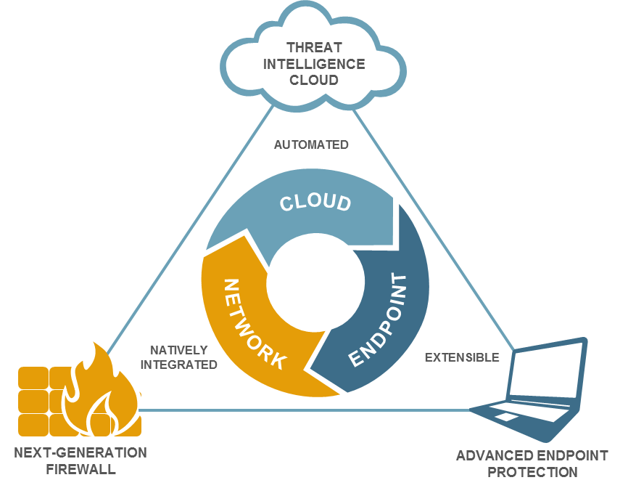
Next-Generation Security Platform
Next-Generation Firewall
Threat Intelligence Cloud
Identifies and inspects all traffic
Blocks known threats
Sends unknown to cloud
Extensible to mobile and virtual networks
Gathers potential threats from network and endpoints
Analyzes and correlates threat intelligence
Disseminates threat intelligence to network and endpoints
Advanced Endpoint Protection
Inspects all processes and files
Prevents both known and unknown exploits
Integrates with cloud to prevent known and unknown malware

Slide 15
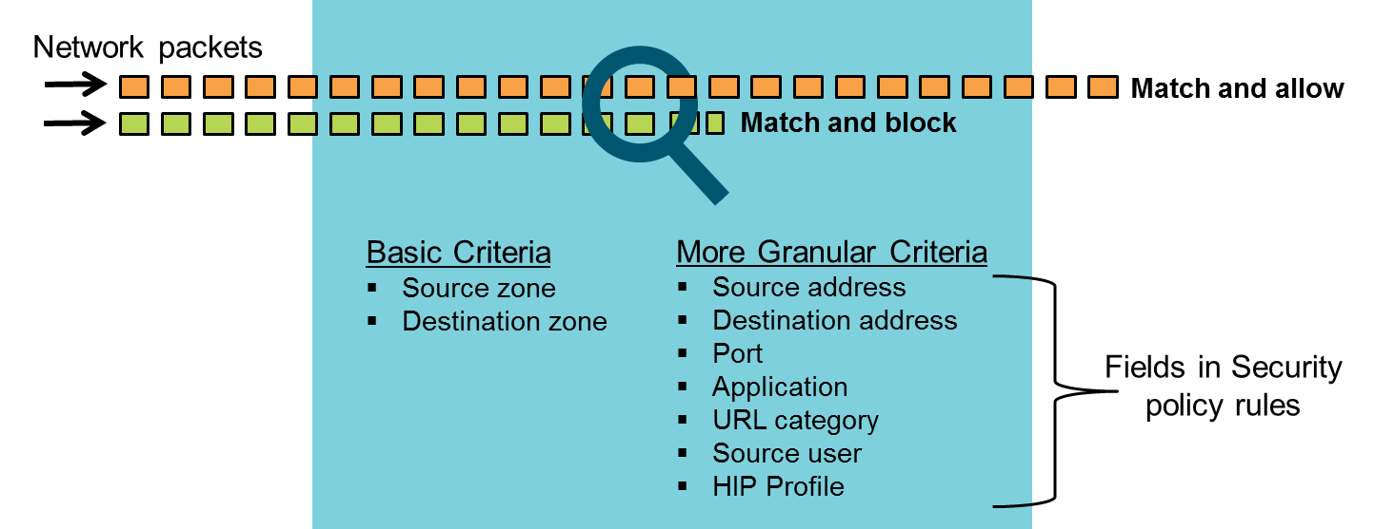
Security Policy Fundamental Concepts
Multiple match criteria available to control network traffic
You can define Security policy rules to allow or deny traffic starting with the source and destination zones as the broad criteria, then fine-tune the rules with more granular options such as source and destination IP addresses, ports, applications, URL categories, source user, and HIP Profiles.

Slide 16


Sessions and Flows
Session
c2s flow – must enable using rule
Traffic initiator
(client)
Traffic responder
(server)
s2c flow – return traffic allowed
The Palo Alto Networks firewall is a stateful firewall, which means that all traffic passing through the firewall is matched against a session and each session is then matched against a Security policy rule.
A session can consist of one or two flows: the client-to-server flow (c2s flow) and the server-to-client flow (s2c flow).
The endpoint where traffic initiates is always the client, and the endpoint where traffic is destined is the server.
When you define Security policy rules, consider only the c2s flow direction. Define policy rules that allow or deny traffic from the source zone to the destination zone, that is, in the c2s direction.
The return s2c flow does not require a separate rule because the return traffic is automatically allowed.

Slide 17
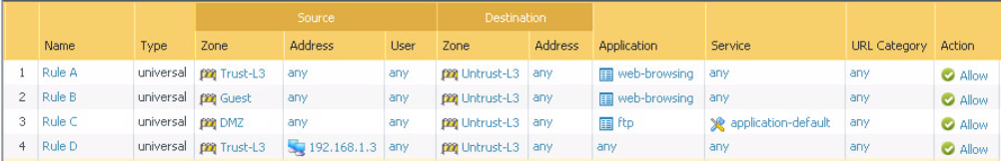
Recall: Security Policy Rule Match
Rules evaluated from top to bottom
Further rules not evaluated after a rule match
Could Rule A and Rule B be combined?
Yes.
Place Trust-L3 and Guest together in source zone
Untrust-L3 remains in destination zone

Slide 18
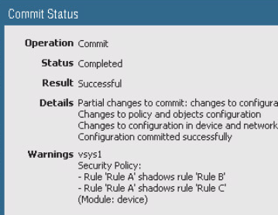
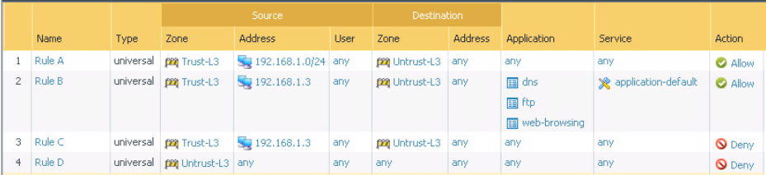
Rule Shadowing
Traffic can match multiple rules.
Earlier rule hides (casts a shadow over) later rule
Reorder or refine rules to remove shadowing

Slide 19
Rule Shadowing
In the example, the IP address 192.168.1.3 belongs to the Trust zone and the subnet 192.168.1.0/24. Because the firewall does a Security policy lookup from top to bottom, all traffic from IP address 192.168.1.3 matches Rule A.
Although the traffic from 192.168.1.3 also matches Rule B and Rule C, these rules will not be used because Rule A matches first. This behavior between Security policy rules is called shadowing because Rule A casts a shadow over, or hides, rules Rule B and Rule C.
At a minimum, Rule B and Rule C should precede Rule A to avoid shadowing in this example. Rule A could also be removed and replaced by another, better defined rule.

Slide 20
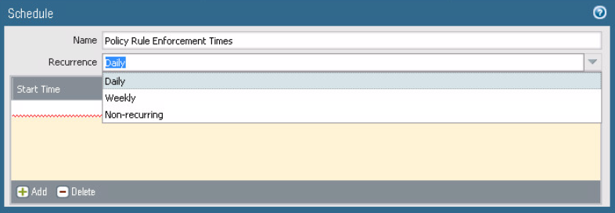
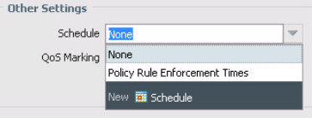
Scheduling Security Policy Rules
Policy rules may be enforced on only specific days and time periods.
Use 24-hour time format
Can specify:
Daily
Days of week
Calendar days
Objects > Schedules > Add
Create a schedule with one or more start/end times
Policies > Security > <select_rule> > Actions
Apply schedule to a rule

Slide 21
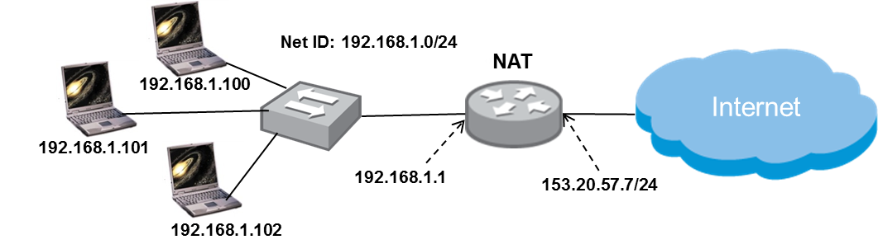
Network Address Translation (NAT)
A technique to hide the internal address from the external network.
Allow one or a small set of public IP addresses to be used by many hosts behind the router/firewall.

Slide 22
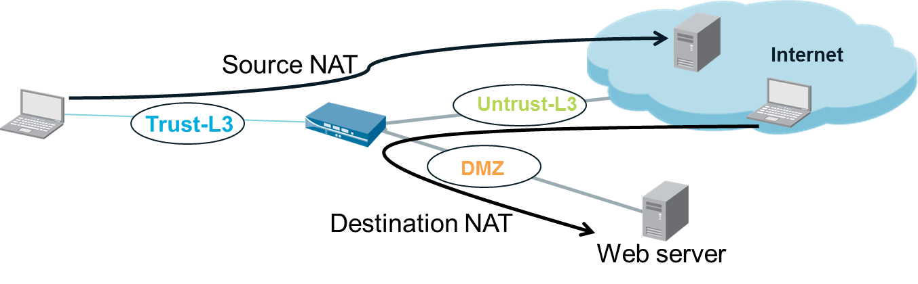
Source NAT & Destination NAT
Source NAT is commonly used for private (internal) users to access the public internet (outbound traffic).
Destination NAT often is used to provide external (public) access to servers on the private network (inbound traffic).

Slide 23




Source NAT
Source NAT translates an original source IP address to an alternate source IP address.
Internet
Untrust-L3
Trust-L3
198.51.100.22
192.168.15.47
203.0.113.38
DMZ
Before:
After:
Source | Destination
192.168.15.47 | 203.0.113.38
Trust-L3 | Untrust-L3
Source | Destination
198.51.100.22 | 203.0.113.38
Untrust-L3 | Untrust-L3
Notes:
Source NAT by definition changes the source address of packets that match the NAT policy as the packets transit the firewall. Depending on the firewall configuration, source NAT also might change the source port number. Source NAT commonly is used to allow host devices configured with a private IP address to send and receive traffic on the internet.
This graphic shows the firewall performing a source NAT function. A host residing at 192.168.15.47 on the private network needs to access a service residing at 203.0.113.38 on the public internet. The firewall receives the host traffic on the Trust-L3 interface and forwards it on the Untrust-L3 interface, replacing the original source IP of the packet with the configured Untrust-L3 interface IP of the firewall.
Without this translation, traffic from the host would be discarded by the ISP carrier because it would be sourced from a private address, 192.168.15.47. Source NAT translates the private address and makes the traffic routable across the internet.

Slide 24
Source NAT Types
Dynamic IP/Port (DIPP)
Multiple clients use the same public IP addresses with different source port numbers
Assigned address can be set to Interface address or Translated address
Dynamic IP
1-to-1 translations
Private source addresses translate to the next available address in the range
Source port is unchanged
Static IP
1-to-1 fixed translations
Use static IP to change the source IP address while leaving the source port unchanged

Slide 25
NAT Table
Network address translation will translate internal IP addresses to external IP address for Internet access.
At the router, IP address of the internal host 192.168.1.X will be translated to 153.20.57.7 so that it can access to the public Internet.
Network Address and Port Translation
(NAPT) Table at router.
Traffic | Before NAT (Pre-NAT) | After NAT (Post-NAT
Outbound | 192.168.1.100:1025 | 153.20.57.7:1234
Inbound | 153.20.57.7:1234 | 192.168.1.100:1025
Outbound | 192.168.1.101:1025 | 153.20.57.7:1235
Inbound | 153.20.57.7:1235 | 192.168.1.101:1025
Notes:
IP Address: Port Number is also called a Socket.

Slide 26
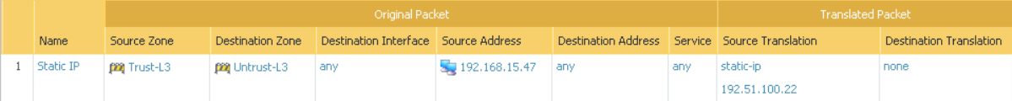
Source NAT Examples
Static 1:1 Translation
Static IP: For this type, a single Original Packet IP address is mapped to a single Translated Packet IP address.
The same address is always used, and the port is unchanged.
For example, if the configured source range is 192.168.0.1 to 192.168.0.10 and the configured translation range is 10.0.0.1 to 10.0.0.10, address 192.168.0.2 is always translated to 10.0.0.2.
However, the number of source IPs using this policy must exactly match the translated address range.

Slide 27
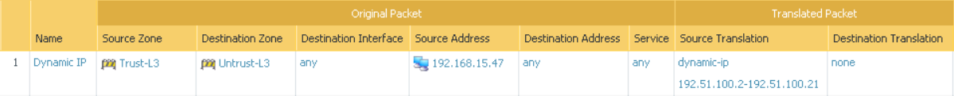
Source NAT Examples (Cont.)
Dynamic IP Translation
Dynamic IP: With this type of NAT, the next available address in the specified range is used, but the port number is unchanged.
Each concurrent session uses an address from the configured pool, making it unavailable to other source IPs.
This option most commonly is used when there are two or more public IPs from the ISP, but not enough public IPs to allocate one to each internal host on the network, and you want to assign them to outbound hosts only as needed.
The translated pool of addresses can be exhausted if the number of internal hosts concurrently creating outbound sessions exceeds the number of IP addresses in the dynamic pool.

Slide 28
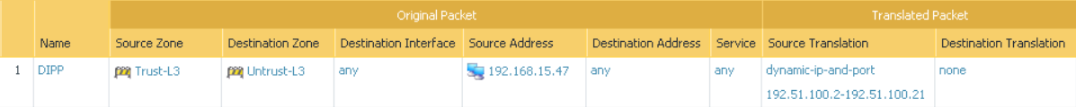
Source NAT Examples (Cont.)
Dynamic IP and Port Translation
Dynamic IP and port: With this type of NAT, an available address in the specified range can be used multiple times because each time the address is paired with a different port number.
This option most commonly is used when there are two or more public IPs from the ISP, but not enough public IPs to allocate one to each internal host on the network.
Because each address is used multiple times by pairing it with a unique port number, DIPP mitigates the problem of having more internal hosts than there are external, routable IP addresses.

Slide 29




Dynamic IP and Port Example
Policies > NAT
192.168.15.47
Trust-L3
Untrust-L3
Internet
e1/1
192.168.15.1
e1/4
172.16.15.1
4.2.2.2
Source | Destination
192.168.15.47:1024 | 4.2.2.2
Translation
Source | Destination
172.16.15.1:2222 | 4.2.2.2
In this example, a host with the IP address 192.168.15.47 exists on an private network. The user at this address wants to connect to a server on the internet. To prevent the exposure of the private IP address, the firewall administrator has configured a NAT policy so that all traffic from the private network appears to come from the address on the ethernet1/4 interface.
A socket comprises IP address and port number e.g. 192.168.15.47:1024
For the translated address, similarly any free port is assigned e.g. 2222 resulting in a socket address, 172.16.15.1:2222

Slide 30
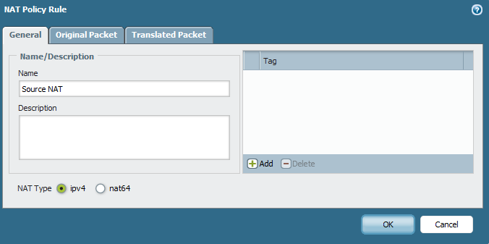
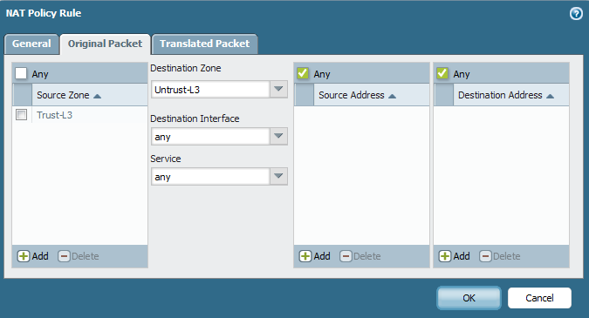
Creating a NAT Policy - Original Packet Tab
Policies > NAT
Notes:
As with any other policy in the firewall, NAT policies are based on the source and destination zones of the traffic being processed.
Two NAT types are supported on Palo Alto Networks firewalls: IPv4 and NAT64.
IPv4 NAT allows an IPv4 address to be translated to another IPv4 address.

Slide 31
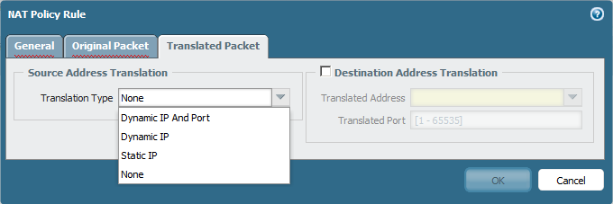
Creating a NAT Policy – Translated Packet Tab
Policies > NAT
Destination NAT
IP Address Pool
Source Port Address Translation
Static 1:1 Translation
Notes:
NAT policies allow the administrator to translate the source address, destination address, or both (i.e. Source NAT and Destination NAT) depending on the needs of the implementation.

Slide 32
Destination NAT
Destination NAT translates an original destination IP address to an alternate destination IP address.
Destination NAT commonly is used to make a server within a private network reachable from the public internet.
Internet
198.51.100.22
192.0.2.5
Untrust-L3
Trust-L3
DMZ
After:
Before:
Source | Destination
192.0.2.5 | 192.168.16.2
Untrust-L3 | DMZ
Source | Destination
192.0.2.5 | 198.51.100.22
Untrust-L3 | Untrust-L3
www.ns.com
192.168.16.2

Slide 33
Destination NAT Types
Static IP
For inbound traffic: 1-to-1 translations
Use static IP to change the destination IP address while leaving the destination port unchanged
Port Forwarding
Port forwarding is a NAT technique used to manage traffic based on destination port numbers. For example, assume that a company has separate servers for email, web hosting, and applications. All three reside in a zone named DMZ. All systems in DMZ are externally reachable through a NAT policy that maps them all to the same IP address. When traffic is received at the shared address, the port forwarding feature of the NAT policy sends the traffic to the appropriate server based on the destination port associated with the session.

Slide 34
Summary
Layer 3 Interfaces
Interface Management Profile
DHCP
Virtual Routers
NAT

